Slide 1
Ethics in Information Technology
Chapter 1
An Overview of Ethics

Slide 2
Objectives
What is ethics, and why is it important to act according to a code of ethics?
Why is business ethics becoming increasingly important?
What are organizations doing to improve their business ethics?

Slide 3
Objectives (cont’d)
What is corporate social responsibility?
Why are organizations interested in fostering corporate social responsibility and good business ethics?
What approach can you take to ensure ethical decision making
What trends have increased the risk of using information technology in an unethical manner?

Slide 4
What is Ethics?
Ethics is a set of beliefs about right and wrong behavior within a society.
Moral code
Set of rules
Establishes boundaries of generally accepted behaviour
Different rules often have contradictions
Morality
a set of social conventions about right and wrong that are so widely shared that they become the basis for an established consensus.

Slide 5
What is Ethics? (cont’d)
Morality may vary by:
Age
Cultural group
Ethnic background
Religion
Life experiences
Education
Gender

Slide 6
Definition of Ethics
Ethics
Set of beliefs about right and wrong behavior
Note that ethical behavior conforms to generally accepted norms—many of which are almost universal.
Virtues
Habits that incline people to do what is acceptable behavior
Vices
Habits of unacceptable behavior
Virtues and vices define a personal value system
Scheme of moral values

Slide 7
The Importance of Integrity
Integrity is a cornerstone of ethical behaviour
People with integrity:
Act in accordance with a personal code of principles
Extend to all the same respect and consideration
Apply the same moral standards in all situations
Lack of integrity emerges if you apply moral standards differently according to situation or people involved
Many ethical dilemmas are not as simple as right versus wrong

Slide 8
The Difference Between Morals, Ethics, and Laws
Morals: are one’s personal beliefs about right and wrong.
Ethics: standards or codes of behavior expected of an individual by a group (nation, organization, profession) to which an individual belongs.
Law: is a system of rules that tells us what we can and cannot do.
Laws are enforced by a set of institutions
Legal acts conform to the law
Moral acts conform to what an individual believes is the right belief of right and wrong

Slide 9
Teaching Tip | Give examples of behaviors that may be considered ethical in one culture but unethical in another.
Teaching Tip | Give examples of situations in which it might be difficult to be consistent in applying moral standards.

Slide 10
Ethics in the Business World
Both the likelihood and the negative impact of inappropriate behaviour have increased
Several trends have increased the likelihood of unethical behaviour:
Globalization creating complex work environments
Organizations challenged to maintain profits / revenue
Heightened vigilance by:
Employees
Shareholders
Regulatory agencies

Slide 11
Ethics in the Business World (cont’d)
Recent scandals in IT companies
Satyam Computer Services (India)
Hewlett Packard
Computer Associates International
IBM
Not just executives, but even lower-level employees, can find themselves in the middle of an ethical dilemma

Slide 12
Ethics in the Business World (cont’d)

Slide 13
Teaching Tip | Is corporate social responsibility responsible? To learn more, visit: http://www.forbes.com/2006/11/16/leadership-philanthropy-charity-lead-citizen-cx_ba_1128directorship.html
Teaching Tip | Vignette—Cisco Chairman and CEO Advocates Ethical Behavior Describe some of the ways in which Cisco fulfills its corporate social responsibilities and how it emphasizes maintaining high ethical business standards. With the help of examples, discuss how Cisco balances its primary mission and its resources and is still able to act ethically.

Slide 14
Corporate Social Responsibility (CSR)
Corporate Social Responsibility (CSR): Organization taking responsibility for the impact of its actions on the:
Environment
Community
Welfare of its employees
Supply chain sustainability: a component of CSR that focuses on Developing and maintaining a supply chain that meets the needs of the present without compromising the ability of future generations to meet their needs

Slide 15
Why Fostering Corporate Social Responsibility and Good Business Ethics is Important
Gaining the goodwill of the community
Creating an organization that operates consistently
Fostering good business practices
Protecting organization/employees from legal action
Avoiding unfavorable publicity

Slide 16
Gaining the Good Will of the Community
Organizations have fundamental responsibilities to society
Declared in formal statement of company’s principles or beliefs
Socially responsible activities create goodwill
Making contributions to charitable organizations and non-profit institutions
Providing benefits for employees in excess of legal requirements
Choosing economic opportunities that might be more socially desirable than profitable
Goodwill makes it easier for corporations to conduct business

Slide 17
Creating an Organization that Operates Consistently
Consistency ensures that employees:
Know what is expected of them
Can employ the organization’s values to help them in decision making
Consistency also means that shareholders, customers, suppliers, and community know what they can expect of the organization

Slide 18
Creating an Organization that Operates Consistently (cont’d)
Many companies share the following values:
Operate with honesty and integrity, staying true to organizational principles
Operate according to standards of ethical conduct, in words and action
Treat colleagues, customers, and consumers with respect
Strive to be the best at what matters to the company
Value diversity
Make decisions based on facts and principles

Slide 19
Creating an Organization that Operates Consistently (cont’d)

Slide 20
Fostering Good Business Practices
Good ethics means good business/improved profits
Companies that:
Produce safe and effective products
Avoid costly recalls and lawsuits
Provide excellent service that retains customers
Develop and maintain strong employee relations
Suffer lower turnover rates
Enjoy better employee morale

Slide 21
Fostering Good Business Practices (cont’d)
Suppliers/business partners place priority on working with companies that operate in a fair and ethical manner
Bad ethics means bad business/waning profits
Bad ethics can lead to bad business results
Bad ethics can have a negative impact on employees

Slide 22
Protecting the Organization and Its Employees from Legal Actions
U.S. Supreme Court established that an employer can be held responsible for the acts of its employees
This principle is called respondent superior
Coalition of several legal organizations argues establishment of ethics and compliance programs should reduce criminal liability of organization
Others argue company officers should not be given light sentences if their ethics programs are ineffective

Slide 23
Avoiding Unfavourable Publicity
Public reputation of company strongly influences:
Value of its stock
How consumers regard products and services
Degree of oversight received from government
Amount of support and cooperation received
Organizations are motivated to build strong ethics programs to avoid negative publicity

Slide 24
Teaching Tip | To learn about the ethical guidelines for board members of not-for-profit organizations, visit: http://www.axi.ca/tca/mar2004/guestarticle_4.shtml

Slide 25
Improving Corporate Ethics
Characteristics of a successful ethics program
Employees willing to seek advice about ethical issues
Employees feel prepared to handle situations that could lead to misconduct
Employees are rewarded for ethical behavior
Employees are not rewarded for success obtained through questionable means
Employees feel positive about their company

Slide 26
Appointing a Corporate Ethics Officer
Corporate ethics officer
provides an organization with vision and leadership in the area of business conduct.
Should be well-respected, senior-level manager who reports directly to the CEO
Aligns the practices of a workplace with the stated ethics and beliefs of that workplace, holding people accountable to ethical standards.
Ensures ethical procedures are put in place
Creates and maintains ethics culture
Is responsible for key knowledge/contact person for ethical issues

Slide 27
Ethical Standards Set by Board of Directors
Board of directors: is responsible for the careful and responsible management of an organization.
In a for-profit organization, the board’s primary objective is to oversee the organization’s business activities and management for the benefit of all stakeholders.
Board members of company are expected to:
Conduct themselves according to the highest standards of personal and professional integrity
Set standard for company-wide ethical conduct
Ensure compliance with laws and regulations
Create environment in which employees can seek advice about business conduct, raise issues, and report misconduct

Slide 28
Establishing a Corporate Code of Ethics
Code of ethics
Highlights an organization’s key ethical issues
Identifies overarching values and important principles
Focuses employees on areas of ethical risk
Offers guidance for employees to recognize and deal with ethical issues
Provides mechanisms to report unethical conduct
Help employees abide by the law, follow necessary regulations, and behave in an ethical manner

Slide 29
Establishing a Corporate Code of Ethics (cont’d)
Sarbanes-Oxley Act of 2002
Enacted in response to public outrage over several major accounting scandals
Section 404 requires that the CEO and CFO sign any SEC filing to attest to its accuracy
Section 406 of the Sarbanes-Oxley Act requires public companies to disclose whether or not they have a code of ethics and if any waivers to that code have been granted

Slide 30
Teaching Tip | To learn more about the Sarbanes-Oxley Act, encourage students to visit: http://thomas.loc.gov/cgi-bin/query/z?c107:H.R.3763.ENR:%20# https://en.wikipedia.org/wiki/Sarbanes%E2%80%93Oxley_Act

Slide 31
Establishing a Corporate Code of Ethics (cont’d)
Cannot gain company-wide acceptance unless it is:
Developed with employee participation
Fully endorsed by organization’s leadership
Must continually be applied to company’s decision making and emphasized as part of its culture
Breaches in the code of ethics must be identified and dealt with appropriately

Slide 32
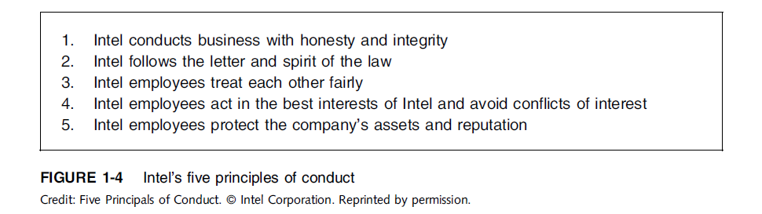
Establishing a Corporate Code of Ethics (cont’d)

Slide 33
Conducting Social Audits
Social audit
Reviews how well organization is meeting ethical and social responsibility goals
Communicates new goals for upcoming year
Shared broadly with employees, shareholders, investors, market analysts, customers, suppliers, government agencies, and local communities

Slide 34
Requiring Employees to Take Ethics Training
Personal convictions improved through education
Comprehensive ethics education program encourages employees to act responsibly and ethically
Often presented in small workshop formats
Employees apply code of ethics to hypothetical but realistic case studies
Demonstration of recent company decisions based on principles from the code of ethics

Slide 35
Requiring Employees to Take Ethics Training (cont’d)
Critical that training increase the percentage of employees who report incidents of misconduct
Employees must:
Learn effective ways of reporting incidents
Be reassured their feedback will be acted on without retaliation

Slide 36
Including Ethical Criteria in Employee Appraisals
Only 43% of companies include ethical conduct in employee’s performance appraisal
Ethical criteria include:
Treating others fairly and with respect
Operating effectively in a multicultural environment
Accepting personal accountability
Continually developing themselves and others
Operating openly and honestly with all

Slide 37
Creating an Ethical Work Environment
Good employees may make bad ethical choices
May be encouraged to do “whatever it takes” to get the job done, employees may feel pressure to engage in unethical conduct to meet management’s expectations.
Employees need a knowledgeable resource to discuss perceived unethical practices
A manager
Legal or Internal Audit Department
Business Unit’s legal counsel
Anonymously through internal Web site

Slide 38
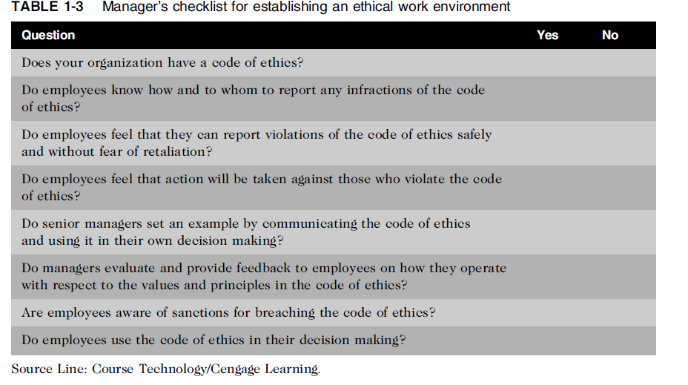
Creating an Ethical Work Environment (cont’d)

Slide 39
Including Ethical Considerations in Decision Making
Steps in a decision-making process
Develop problem statement
Identify alternatives
Evaluate and choose alternative
Implement decision
Evaluate results
Success

Slide 40
Develop a Problem Statement
Clear, concise description of the issue
Answers these questions:
What causes people to think there is a problem?
Who is directly affected by the problem?
Is there anyone else affected?
How often does it occur?
What is the impact of the problem?
How serious is the problem?
Most critical step in decision-making process

Slide 41
Develop a Problem Statement (cont’d)
Example of a good problem statement:
“Our product supply organization is continually running out of stock of finished products, creating an out-of-stock situation on over 15 percent of our customer orders, resulting in over $300,000 in lost sales per month.”
Examples of poor problem statements:
“We need to implement a new inventory control system.” (possible solution, not a problem statement)
“We have a problem with finished product inventory.” (not specific enough)

Slide 42
Identify alternatives, Evaluate and Choose an Alternative
Enlist help to brainstorm alternative solutions
Consider likely consequences of each alternative
Alternative selected must:
Evaluate by weighing laws, guidelines, and principles
Be ethically and legally defensible
Be consistent with policies and code of ethics
Take into account impact on others
Provide a good solution to problem

Slide 43
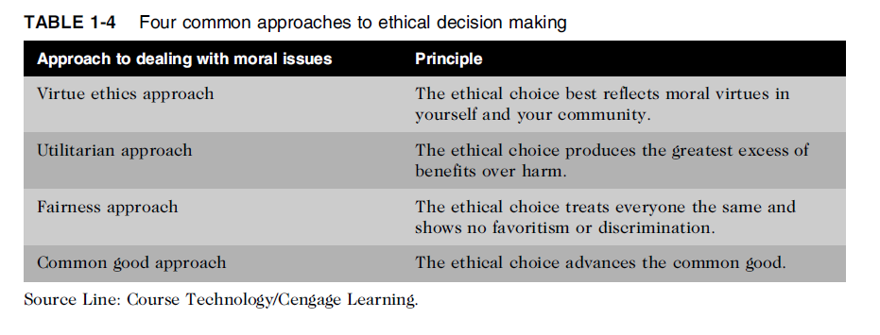
Common Approaches to Ethical Decision Making
Evaluate and Choose an Alternative
Table 1-5 Four common approaches to ethical decision making

Slide 44
Virtue Ethics Approach
Virtue ethics approach
Focuses on concern with daily life in a community
People guided by virtues to reach “right” decision
More effective than following set of principles/rules
Problems
Does not provide guide for action
Virtue cannot be worked out objectively; depends on circumstances

Slide 45
Utilitarian Approach
Utilitarian approach
Chooses action that has best overall consequences
Finds the greatest good by balancing all interests
Fits concept of value in economics and the use of cost-benefit analysis
Problems
Measuring and comparing values is often difficult
Predicting resulting benefits and harm is difficult

Slide 46
Fairness Approach
Fairness approach
Focuses on fair distribution of benefits/burdens
Guiding principle is to treat all people the same
Problems
Decisions can be influenced by personal bias
Others may consider the decision unfair

Slide 47
Common Good Approach
Common good approach
Work together for common set of values and goals
Implement systems that benefit all people
Problems
Consensus is difficult
Some required to bear greater costs than others

Slide 48
Implement the Decision and Evaluate the Results
Implement the decision
Efficient, effective, timely implementation
Communication is key for people to accept change
Transition plan made easy and pain-free
Evaluate the results
Monitor results for desired effect
Observe impact on organization and stakeholders
Return to “Develop problem statement” step if further refinements may be needed

Slide 49
Ethics in Information Technology
Public concern about the ethical use of information technology includes:
E-mail and Internet access monitoring
Downloading in violation of copyright laws
Unsolicited e-mail (spam)
Hackers and identify theft
Students and plagiarism
Cookies and spyware

Slide 50
Ethics in Information Technology (cont’d)
The general public does not understand the critical importance of ethics as applied to IT
Important decisions are often left to technical experts
General business managers must assume greater responsibility for these decisions by:
Making decisions based on technical savvy, business know-how, and a sense of ethics
Creating an environment where ethical dilemmas can be discussed openly, objectively, and constructively

Slide 51
Ethics in Information Technology (cont’d)
Goals of this text
To educate people about the tremendous impact of ethical issues in the successful and secure use of information technology
To motivate people to recognize these issues when making business decisions
To provide tools, approaches, and useful insights for making ethical decisions

Slide 52
Summary
Ethics is important because the risks associated with inappropriate behavior have increased
Organizations have at least five good reasons for encouraging employees to act ethically
To gain the good will of the community
To create an organization that operates consistently
To foster good business practices
To protect the organization and its employees against legal action
To avoid unfavorable publicity

Slide 53
Summary (cont’d)
Organizations require successful ethics programs
The corporate ethics officer ensures that ethical procedures are installed and followed
Managers’ behaviors and expectations can strongly influence employees’ ethical behavior
Most of us have developed a simple decision-making model that includes five steps
Ethical considerations must be incorporated into decision making

Slide 54
Summary (cont’d)
Four common approaches to ethical decision making
Virtue ethics approach
Utilitarian approach
Fairness approach
Common good approach

Slide 55
Reference
Ethics in Information Technology, George W. Reynolds, Fifth Edition

